Slide 1

Zomato Order & Restaurant Analysis Using Power BI

Slide 2
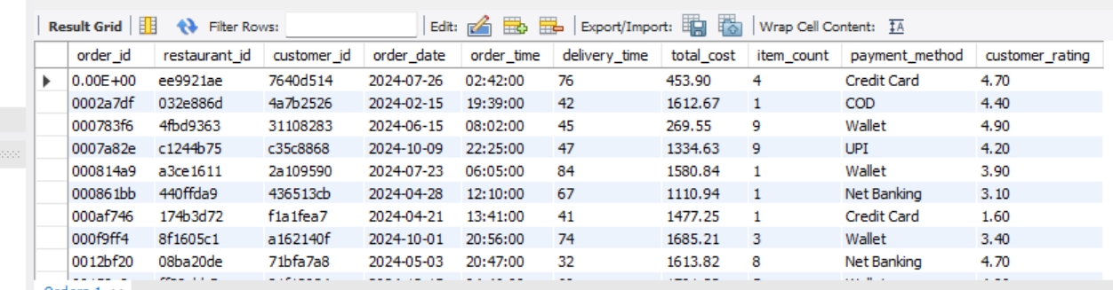
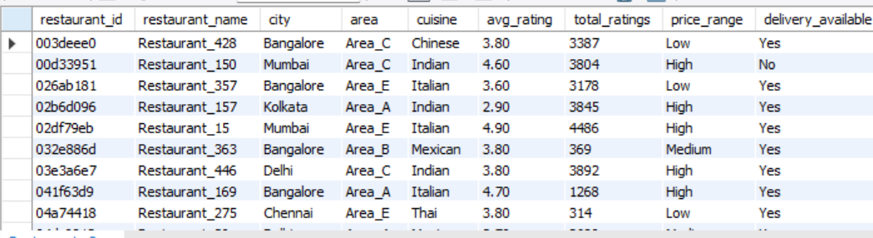
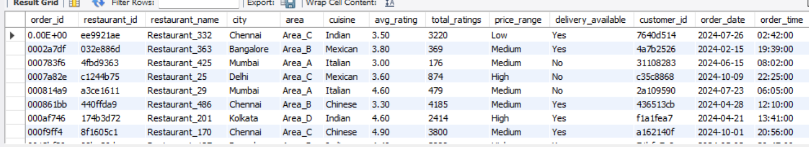
Task 1: Upload Dataset into MySQL
Task 2: Perform Simple Data Transformations Using SQL
Upload Dataset into MySQL
Created Zomato database.
Created Restaurants and Orders tables.
Imported CSV datasets into MySQL.
SQL Data Transformation
Cleaned duplicates and NULL values.
Performed SQL analysis and aggregations.
Identified Top 5 cities and restaurants.
Joined Orders and Restaurants tables.
Exported transformed data to Excel.

Slide 3

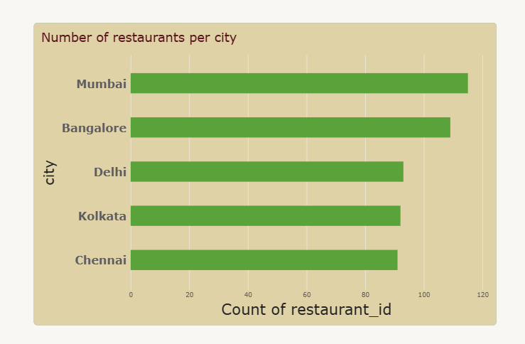
Task1 : Number of Restaurants per City
Created a bar chart showing restaurants by city.
Identified cities with the highest and lowest restaurant counts.
Compared restaurant availability across cities.
Business Insight: Identified high-potential cities for restaurant expansion and business growth.

Slide 4
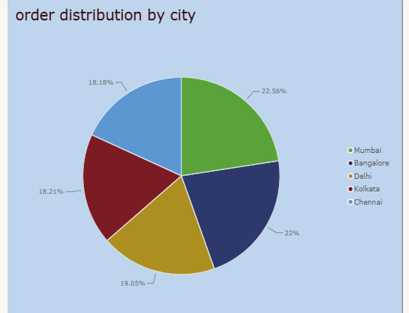
Task 2:Percentage of Orders from Different Cities
Visualized order percentages by city using a pie chart.
Identified cities with the highest and lowest order shares.
Business Insight: Focused on high-demand cities for targeted marketing.

Slide 5
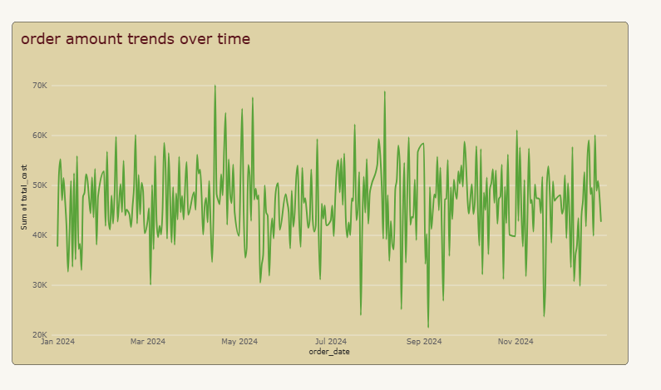
Task 3: Order Amount Trends Over Time
Created a line chart showing order amounts over time.
Identified peak and low sales periods.
Business Insight: Identified high-demand periods for better sales planning.

Slide 6
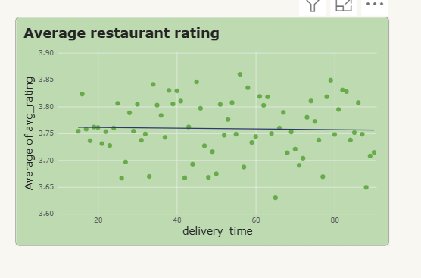
Task 4: Correlation of Factors Affecting Average Rating
Created a scatter plot to compare delivery time and ratings.
Observed no clear relationship between delivery time and ratings.
Business Insight: Ratings are influenced by factors beyond delivery time.

Slide 7
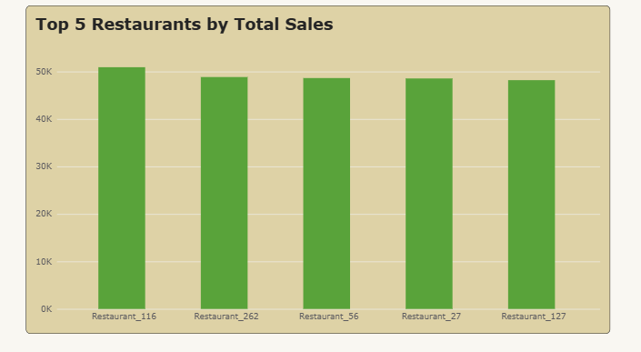
Task 5: Top 5 Restaurants by Total Sales
Created a column chart showing the top 5 restaurants by sales.
Identified the highest-revenue restaurants.
Business Insight: Identified top-performing restaurants for growth strategies.

Slide 8
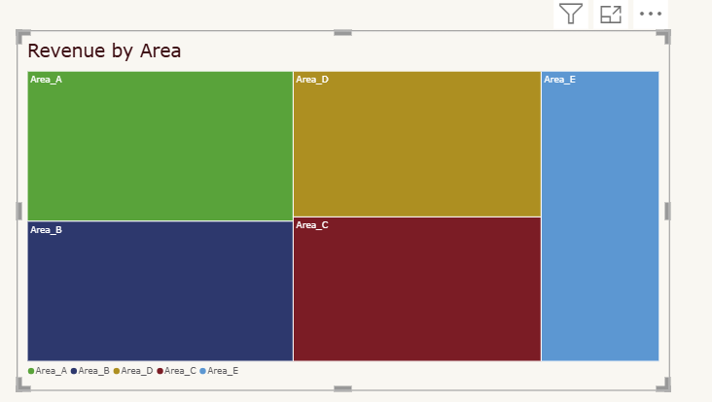
Task 6: Revenue by Area Using a Tree Map
Created a tree map showing revenue by area.
Identified high- and low-revenue areas.
Business Insight: Helps focus marketing and expansion on high-revenue areas.

Slide 9
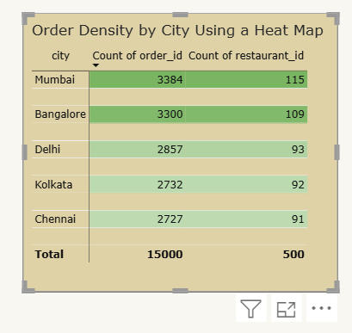
Task 7: Order Density by City Using a Heat Map
Created a heat map showing order density by city.
Identified cities with the highest and lowest order volumes.
Business Insight: Helps focus delivery and marketing efforts on high-demand cities.

Slide 10
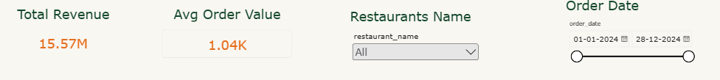
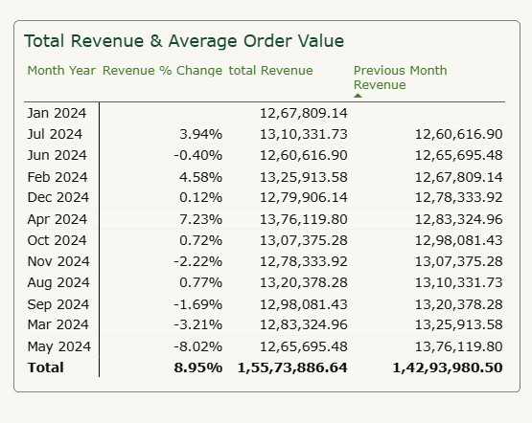
Task 8: KPI Cards – Total Revenue & Average Order Value
Created KPI cards for Total Revenue and Average Order Value.
Displayed key business performance metrics clearly.
Business Insight: Helps monitor revenue and average customer spending.

Slide 11
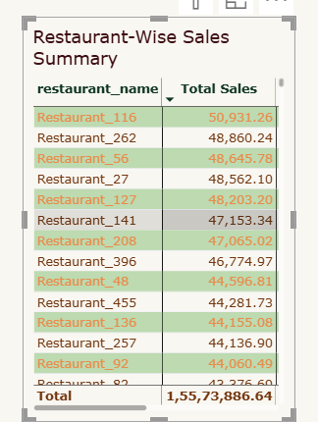
Task 9: Restaurant-Wise Sales Summary in a Table
Created a table showing restaurant-wise sales performance.
Sorted restaurants by sales in descending order.
Business Insight: Helps identify top- and low-performing restaurants.

Slide 12
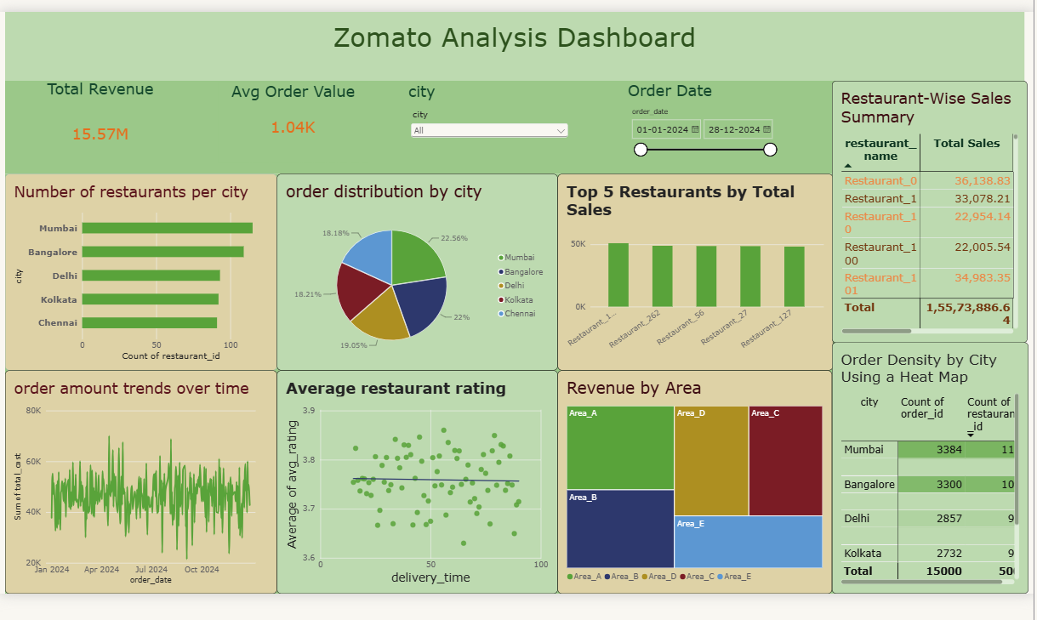
Task 10: Power BI Dashboard – Combining All Visuals
Combined all key visuals into an interactive Power BI dashboard.
Added slicers and filters for easy data analysis.
Business Insight: Provides a complete view of sales, orders, and restaurant performance.

Slide 13

Recommendation:
Focus marketing and promotions on high-order cities and high-revenue areas.
Support top-performing restaurants with more promotions and growth opportunities.
Improve performance in low-order and low-revenue areas through targeted offers.
Monitor delivery time, ratings, revenue, and order trends regularly.
Use the Power BI dashboard to make data-driven business decisions.

Slide 14
THANK YOU

